Slide 1
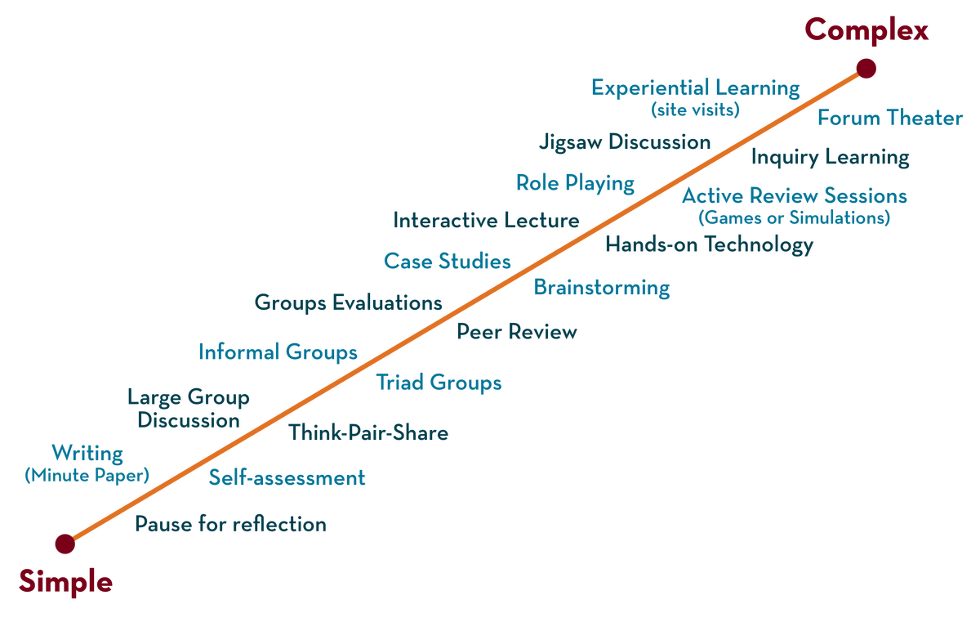
NETWORKS, PROTOCOLS & SECURITY (NPS) 22EC2210R Topic: Introduction to computer networks uses of computer networks
Session - 01

Slide 2




AIM OF THE SESSION
To familiarize students with the basic concept of Computer Networks and its necessity
INSTRUCTIONAL OBJECTIVES
This Session is designed to:
Introduction to Computer Networks ,
Use of Computer Networks .
LEARNING OUTCOMES
At the end of this session, you should be able to:
Describe the uses of Computer Networks
Describe the components of the Computer Networks

Slide 3
Syllabus
Introduction to Computer networks, uses of computer networks, Network Hardware, Network software, Reference models: OSI and TCP/IP, Example Networks

Slide 4
Introduction to computer networks
“A set of communication elements connected by communication links”
Communication elements
Computers, printers, mobile phones, …
Routers, switches, ...
➭ Communication links
optic fiber
coaxial cable
twisted pair
wireless (radio, microwave, satellite)
➭ Topologies
Ring, Star, Bus, Tree, Mesh

Slide 5
A software/hardware infrastructure
➭ Share resources
data, files, computing power, video,…
➭ Information highway
communication between geographically dispersed users
➭ Electronic Society
Cyberspace
Virtual global nation

Slide 6
Uses of Computer Networks
Business Applications
Home Applications
Mobile Users
Social Issues

Slide 7
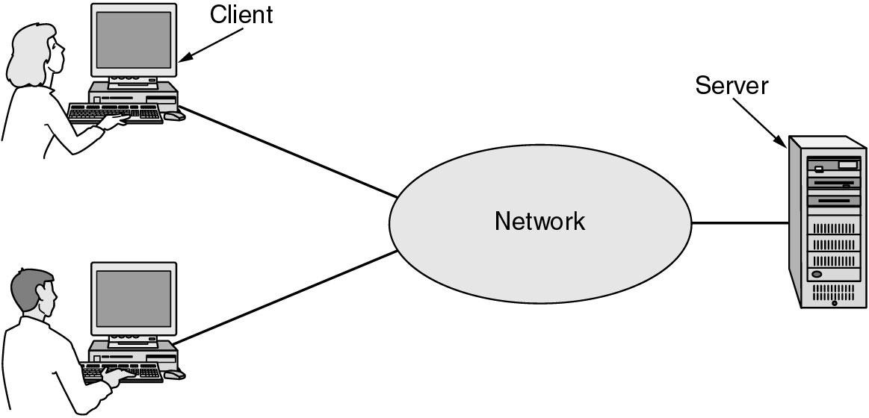
Business Applications of Networks
Resource sharing (hardware, software, information, …)
Providing communication medium (e-mail, videoconferenceing)
Doing business electronically (B2B, B2C, e-commerce)

Slide 8
Goals of Networks for Companies
Resource sharing: equipment, programs, data
high reliability
replicated data
hardware
Saving money
mainframe: 10 times faster, but 1000 times more expensive than PC
client-server model
Scalability
mainframe: replace a larger one
client-server model: add more servers

Slide 9
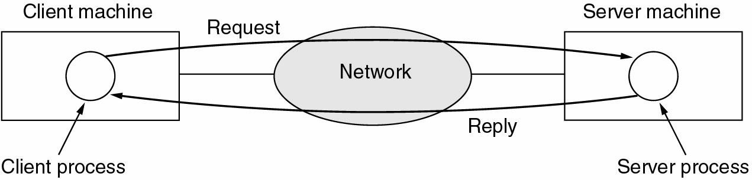
Business Applications of Networks (2)
Two processes are involved
A communication network is needed
The client-server model involves requests and replies.

Slide 10
Home Network Applications
Access to remote information
Person-to-person communication
Interactive entertainment
Electronic commerce

Slide 11
Networks for People
Access to remote information
e.g.: financial, shopping, customized newspapers, on-line digital library, WWW
Person-to-person communication
email, video conference, newsgroup
Interactive entertainment
VOD, interactive movies or TVs, game playing

Slide 12
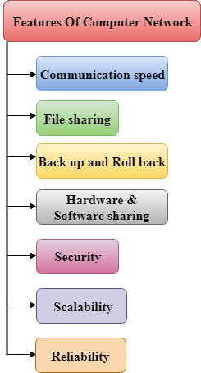
Features Of Computer network

Slide 13
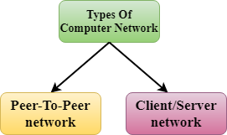
TYPES OF NETWORKS

Slide 14
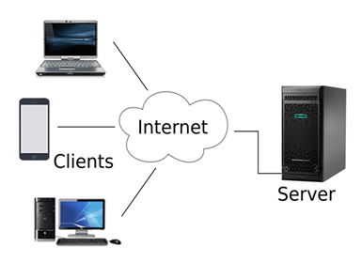
Client/Server Network

Slide 15
COMPUTER NETWORK HARDWARE
Network Cables
Distributors
Routers
Internal Network Cards
External Network Cards

Slide 16
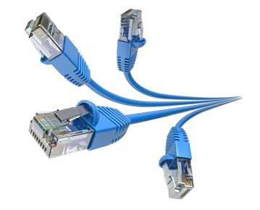
Network Cables
Network cables are used to connect computers. RJ-45 Category 5 cable is the most often used cable.

Slide 17
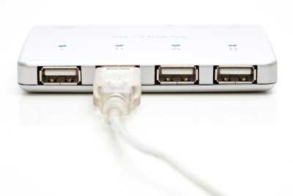
Distributors
A computer may be connected to another using a serial port; however, if we need to connect numerous computers to create a network, this serial connection will fail.

Slide 18
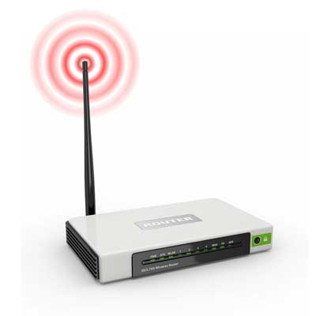
Router
A router is an equipment that serves as the hub for computers and other network-connected devices. It has openings called ports in it. Computers and other devices are connected to a router through network cables. Nowadays, routers are available in wireless modes, allowing computers to be connected without needing a physical connection.

Slide 19
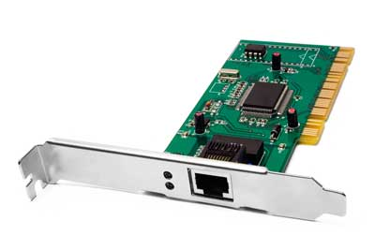
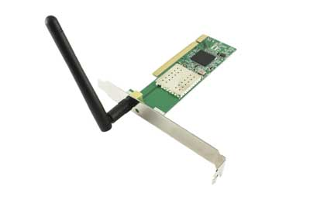
Network Card
A network card is a component of a computer connected to a network computer. It is sometimes referred to as a network adapter or Network Interface Card (NIC). Most brand-name computers come with a network card pre-installed. Internal and external network cards are the two types of network cards.

Slide 20
SELF LEARNING QUESTIONS
1. The IETF standards documents are called ________ a) RFC b) RCF c) ID d) DFC View Answer
Answer: a Explanation: RFC stands for Request For Comments and they are documents that describe methods, behaviors, research, or innovations applicable to the working of the Internet.
2. In the layer hierarchy as the data packet moves from the upper to the lower layers, headers are ___________ a) Added b) Removed c) Rearranged d) Modified View Answer
Answer: a Explanation: Each layer adds its own header to the packet from the previous layer. For example, in the Internet layer, the IP header is added over the TCP header on the data packet that came from the transport layer.
3. The structure or format of data is called ___________ a) Syntax b) Semantics c) Struct d) Formatting View Answer
Answer: a Explanation: The structure and format of data are defined using syntax. Semantics defines how a particular pattern to be interpreted, and what action is to be taken based on that interpretation. In programming languages, syntax of the instructions plays a vital role in designing of the program.

Slide 21
TERMINAL QUESTIONS
What is a computer network, and why are they important?
What is the purpose of a network interface card (NIC), and how does it work?
What is a router, and what role does it play in a network?

Slide 22
REFERENCES FOR FURTHER LEARNING OF THE SESSION
Reference Books:
William Stallings, Wireless Communications & Networks, 2nd edition, Prentice-Hall Pearson,2005
Jochen Schiller, Mobile Communication, (Latest edition), Addison Wesley
G. Wright and W. Stevens, TCP/IP Illustrated, Volume 2, Addison-Wesley, 1996.Computer Networks -- Andrew S Tanenbaum, David. j. Wetherall, 5th Edition. Pearson
Education/PHI
An Engineering Approach to Computer Networks-S. Keshav, 2nd Edition, Pearson Education
Data Communications and Networking – Behrouz A. Forouzan. Third Edition TMH.
Sites and Web links:
1. https://archive.nptel.ac.in/courses/108/106/108106163/
2. https://onlinecourses.nptel.ac.in/noc22_ee32/preview
3. https://onlinecourses.nptel.ac.in/noc23_ee05/preview

Slide 23
THANK YOU
Team – DATA NETWORKS, PROTOCOLS & SECURITY (DNPS)

